Slide 1

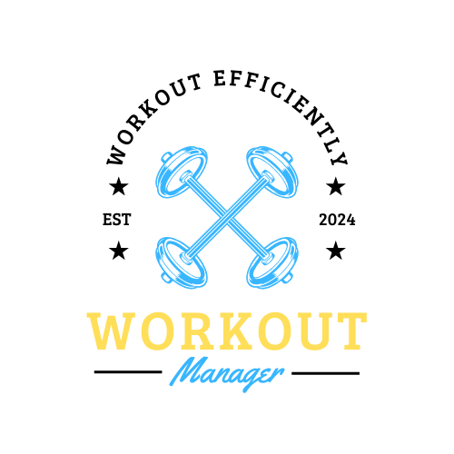
Team: Carys Winne
Workout Manager is designed with the idea of managing and tracking different workouts. It can track different things such as the workout name, how many repetitions to perform, and how many sets to do allowing for a planned and effective trip to the gym.

